Slide 1
In the name of allah the most merciful and benificient

Slide 2
medical Image Analysis
Dr. zobia Suhail
PhD in Medical image processing
Aberystwyth university, Wales, uk (2019)

Slide 3
medical Image Analysis
Overview of Previous Lecture:
Image Features
First Order Statistical Features

Slide 4
medical Image Analysis
Statistical approaches
Co-occurrence matrices
Run length matrices
Local binary patterns
Laws kernels
Gabor filters
........

Slide 5
medical Image Analysis
Statistical approaches
Co-occurrence matrices [Haralick Features]
Run length matrices
Local binary patterns
Laws kernels
Gabor filters
........

Slide 6
medical Image Analysis
Statistical approaches
Co-occurrence matrices [Haralick Features]
Run length matrices
Local binary patterns
Laws kernels
Gabor filters
........

Slide 7
medical Image Analysis
Image Features [Hand-Crafted Features / Manual Features]:
Second Order Statistical features:
One of the most properly used second order statistical features are features introduced
By Haralick features introduced by Haralick et al. In comparison to the first order statistical features,
These features consider the spatial relationship between grey level within a given distance (d) and
Orientation (ϴ).
Grey Level Co-occurrence Matrix (GLCM) is a tabulation of how often different combination
of grey levels occur in an image.
Each value in GLCM represents the probability occurrence of a pair of grey level at a given distance (d)
And orientation (ϴ).
R. M. Haralick. Statistical and structural approaches to texture. Proceedings of the IEEE, 67(5):786{804, May 1979.

Slide 8
medical Image Analysis
Image Features [Hand-Crafted Features / Manual Features]:
Second Order Statistical features:
Mostly first order and second order statistical features are used together for the texture analysis
Because they provide the features related to grey level distributor and spatial relationship
Between the grey level values.
Figure (a) illustrates the spatial relationships of pixels that are defined by distance d=1 and 4 different
Orientations i.e. ϴ = 0º, 45º, 90º, 135º and figure (b) represents the spatial relationship of the pixels defined
By distance d=2 and 0º, 45º, 90º, 135º. Both figures (a) and (b) are representing relationships with respect
To the pixel of interest (the central pixel).
135º
90º
45º
135º
90º
45º
0º
0º
R. M. Haralick. Statistical and structural approaches to texture. Proceedings of the IEEE, 67(5):786{804, May 1979.

Slide 9
medical Image Analysis
Image Features [Hand-Crafted Features / Manual Features]:
Second Order Statistical features:
Second order statistical features are computed in two steps:
The GLCM is constructed.
Features are computed from the constructed GLCM
R. M. Haralick. Statistical and structural approaches to texture. Proceedings of the IEEE, 67(5):786{804, May 1979.

Slide 10
medical Image Analysis
Image Features [Hand-Crafted Features / Manual Features]:
Second Order Statistical features:
GLCM matrix is constructed as:
Create an empty matrix (M) based on the grey level values in the input image I.
1
2
3
4
5
1 | 2 | 3 | 2 | 4
5 | 3 | 2 | 1 | 1
3 | 2 | 1 | 2 | 1
1 | 1 | 5 | 2 | 1
2 | 5 | 4 | 1 | 3
1
2
3
4
5
Input Image I
Matrix M
R. M. Haralick. Statistical and structural approaches to texture. Proceedings of the IEEE, 67(5):786{804, May 1979.

Slide 11
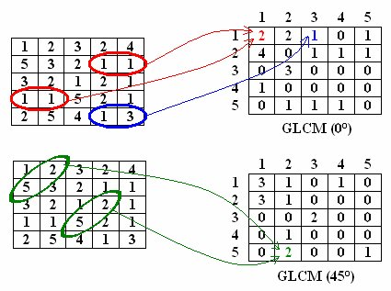
medical Image Analysis
Image Features [Hand-Crafted Features / Manual Features]:
Second Order Statistical features:
GLCM matrix is constructed as:
Choose value of d and ϴ (for example take d=1 and ϴ = 0º)
Fill in the matrix M according to the grey level occurrences in the chosen direction and distance.
Image Courtesy: https://www.researchgate.net/publication/264886592_Computer_Vision-based_Wood_Recognition_System/figures?lo=1

Slide 12
medical Image Analysis
Image Features [Hand-Crafted Features / Manual Features]:
Second Order Statistical features:
GLCM matrix is constructed as:
Fill in the matrix M according to the grey level occurrences in the chosen direction and distance.
Image Courtesy: https://www.researchgate.net/publication/264886592_Computer_Vision-based_Wood_Recognition_System/figures?lo=1

Slide 13
medical Image Analysis
Image Features [Hand-Crafted Features / Manual Features]:
Second Order Statistical features:
GLCM matrix is constructed as:
Create a transpose of the Matrix M.
1
2
3
4
5
1
2
3
4
5
1
3 | 1 | 0 | 1 | 0
3 | 1 | 0 | 0 | 0
0 | 0 | 2 | 0 | 0
0 | 1 | 0 | 0 | 0
0 | 2 | 0 | 0 | 1
1
3 | 3 | 0 | 0 | 0
1 | 1 | 0 | 1 | 2
0 | 0 | 2 | 0 | 0
1 | 0 | 0 | 0 | 0
0 | 0 | 0 | 0 | 1
2
2
3
3
4
4
5
5
M (45)
M^{t}

Slide 14
medical Image Analysis
Image Features [Hand-Crafted Features / Manual Features]:
Second Order Statistical features:
GLCM matrix is constructed as:
Add the corresponding values of the matrices M and M^{t} to construct a symmetric co-occurrence
Matrix M^{s}.
1
2
3
4
5
1
2
3
4
5
1
2
3
4
5
1
3 | 1 | 0 | 1 | 0
3 | 1 | 0 | 0 | 0
0 | 0 | 2 | 0 | 0
0 | 1 | 0 | 0 | 0
0 | 2 | 0 | 0 | 1
1
3 | 3 | 0 | 0 | 0
1 | 1 | 0 | 1 | 2
0 | 0 | 2 | 0 | 0
1 | 0 | 0 | 0 | 0
0 | 0 | 0 | 0 | 1
1
6 | 4 | 0 | 1 | 0
4 | 2 | 0 | 1 | 2
0 | 0 | 4 | 0 | 0
1 | 1 | 0 | 0 | 0
0 | 2 | 0 | 0 | 2
2
2
2
3
3
3
4
4
4
5
5
5
M
M^{t}
M^{s =} M + M^{t}

Slide 15
medical Image Analysis
Image Features [Hand-Crafted Features / Manual Features]:
Second Order Statistical features:
GLCM matrix is constructed as:
Normalize the constructed matrix M^{s}, this is the final constructed GLCM (G).
Each value in the G represents the co-occurrence probability of a pair of grey levels based on the
parameters d and and ϴ.
.
1
2
3
4
5
1
2
3
4
5
1
6 | 4 | 0 | 1 | 0
4 | 2 | 0 | 1 | 2
0 | 0 | 4 | 0 | 0
1 | 1 | 0 | 0 | 0
0 | 2 | 0 | 0 | 2
1
0.2 | 0.13 | 0 | 0.03 | 0
0.13 | 0.07 | 0 | 0.03 | 0.06
0 | 0 | 0.13 | 0 | 0
0.03 | 0.03 | 0 | 0 | 0
0 | 0.07 | 0 | 0 | 0.07
2
2
TO DO
3
3
4
4
5
5
GLCM (G)
Notes:
Sum no-zero values and divide by each entry

Slide 16
medical Image Analysis
Image Features [Hand-Crafted Features / Manual Features]:
Second Order Statistical features:
Based on constructed GLCM matrix (G) Haralick proposed a set of features to describe texture of the
Image.
The following notations are used to compute Haralick features:
Ng is the number of distinct grey levels in G.
X and y are the coordinated used for rows and columns respectively.
p(i,j) is the probability value in matrix G at position (i,j).
µ is the mean of p(i,j)
µ_{x} , µ_{y ,} ϭ_{x ,} ϭ_{y} are the means and standard deviations of p_{x} and p_{y}. The value for p_{x} (i) can be computed by summing
All the values at i^{th} row of matrix G, whereas value for p_{y} (j) can be computed by summing all the values at j^{th}
column of matrix G.

Slide 17
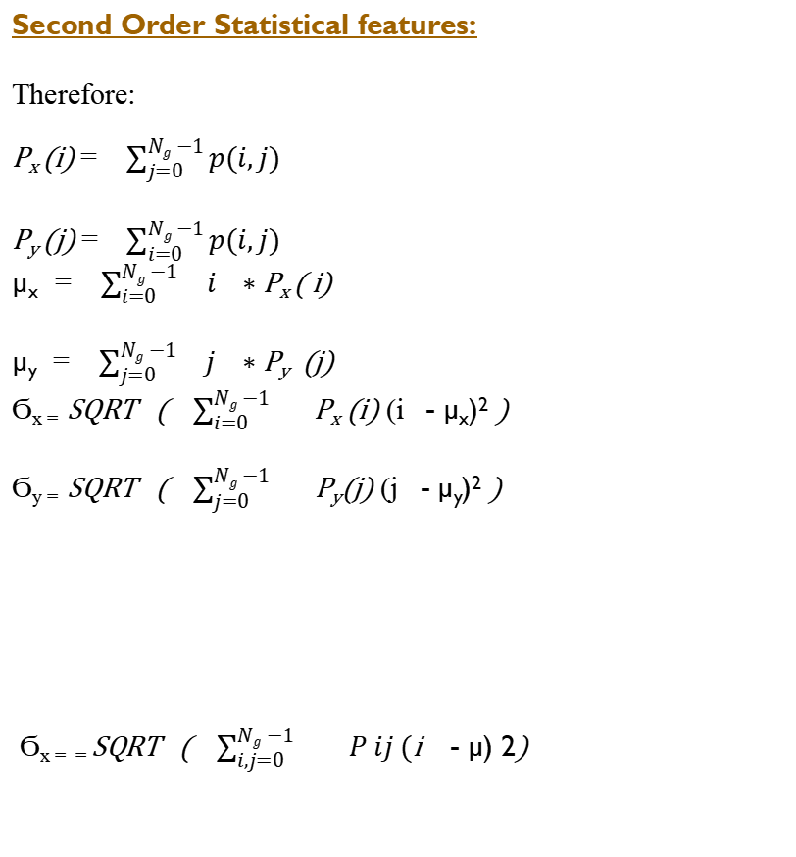
medical Image Analysis
Image Features [Hand-Crafted Features / Manual Features]:
Second Order Statistical features:
Therefore:
P_{x} (i) = $\sum_{j=0}^{Ng −1}{p(i,j)}$
P_{y} (j) = $\sum_{i=0}^{Ng −1}{p(i,j)}$
µ_{x} = $\sum_{i=0}^{Ng −1 }{ i ∗\text{P}\text{x} \text{( }\text{i}\text{)}}$
µ_{y} = $\sum_{j=0}^{Ng −1 }{ j ∗\text{P}\text{y} \text{(}\text{j}\text{)}}$
Ϭ_{x =} SQRT ( $\sum_{i=0 }^{Ng −1 }{\text{P}\text{x}\text{ (}\text{i}\text{)}}$ (i - µ_{x})² )
Ϭ_{y =} SQRT ( $\sum_{j=0 }^{Ng −1 }{\text{P}\text{y}\text{(}\text{j}\text{)}}$ (j - µ_{y})² )
Ϭ_{x = =} SQRT ( $\sum_{i,j=0 }^{Ng −1 }{P ij (\text{i}}$ - µ) 2)
Source Coutesy: https://www.uio.no/studier/emner/matnat/ifi/INF4300/h08/undervisningsmateriale/glcm.pdf

Slide 18
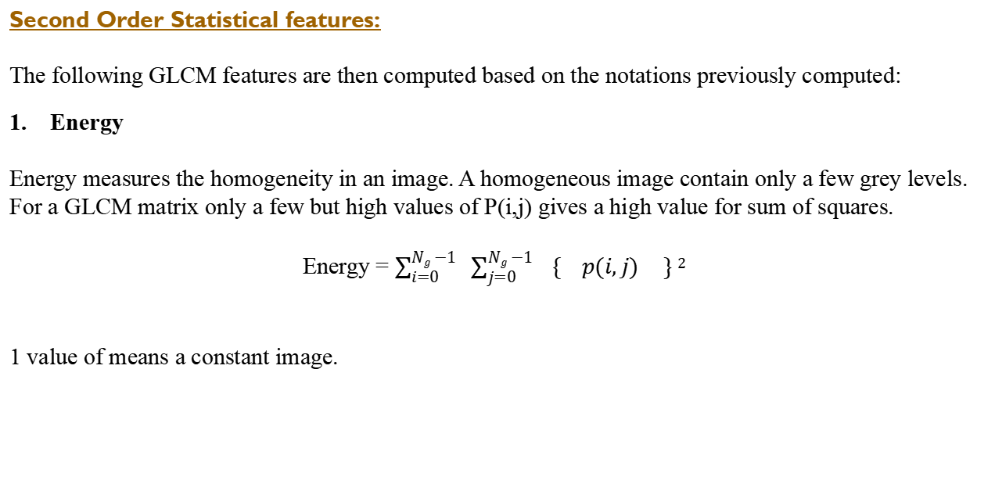
medical Image Analysis
Image Features [Hand-Crafted Features / Manual Features]:
Second Order Statistical features:
The following GLCM features are then computed based on the notations previously computed:
Energy
Energy measures the homogeneity in an image. A homogeneous image contain only a few grey levels.
For a GLCM matrix only a few but high values of P(i,j) gives a high value for sum of squares.
Energy = $\sum_{i=0}^{Ng −1}{ }$ $\sum_{j=0}^{Ng −1}{ \{ p(i,j)} \} 2$
1 value of means a constant image.
Source Courtesy: https://www.uio.no/studier/emner/matnat/ifi/INF4300/h08/undervisningsmateriale/glcm.pdf
https://shodhganga.inflibnet.ac.in/bitstream/10603/20682/14/14_chapter%205.pdf

Slide 19
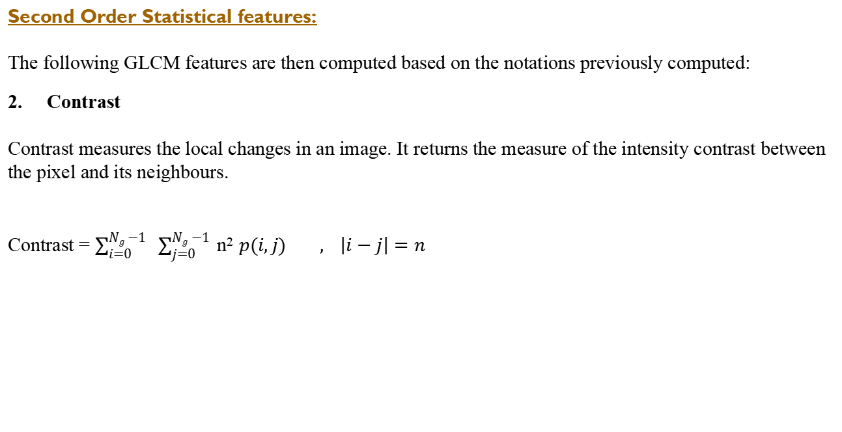
medical Image Analysis
Image Features [Hand-Crafted Features / Manual Features]:
Second Order Statistical features:
The following GLCM features are then computed based on the notations previously computed:
2. Contrast
Contrast measures the local changes in an image. It returns the measure of the intensity contrast between
the pixel and its neighbours.
Contrast = $\sum_{i=0}^{Ng −1}{ }$ $\sum_{j=0}^{Ng −1}{ \text{n}\text{2} p(i,j)} , \left|i−j\right|=n$

Slide 20
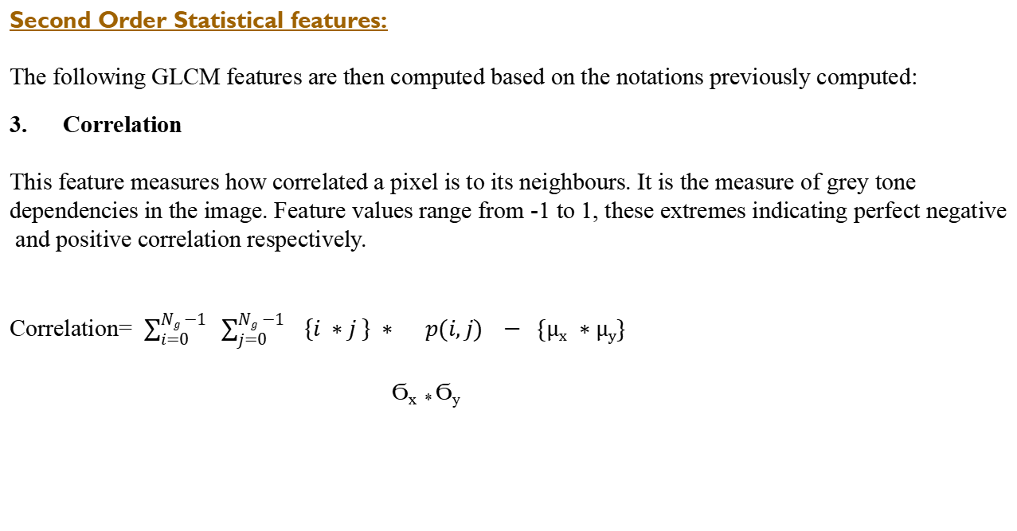
medical Image Analysis
Image Features [Hand-Crafted Features / Manual Features]:
Second Order Statistical features:
The following GLCM features are then computed based on the notations previously computed:
3. Correlation
This feature measures how correlated a pixel is to its neighbours. It is the measure of grey tone
dependencies in the image. Feature values range from -1 to 1, these extremes indicating perfect negative
and positive correlation respectively.
Correlation= $\sum_{i=0}^{Ng −1}{ }$ $\sum_{j=0}^{Ng −1}{ \left\{i ∗j \right\} ∗ p(i,j)} − \{\text{µ}\text{x} ∗\text{µ}\text{y}\}$
Ϭ_{x *} Ϭ_{y}

Slide 21

medical Image Analysis
Image Features [Hand-Crafted Features / Manual Features]:
Second Order Statistical features:
The following GLCM features are then computed based on the notations previously computed:
3. Correlation
This feature measures how correlated a pixel is to its neighbours. It is the measure of grey tone
dependencies in the image. Feature values range from -1 to 1, these extremes indicating perfect negative
and positive correlation respectively.
Correlation= $\sum_{i=0}^{Ng −1}{ }$ $\sum_{j=0}^{Ng −1}{ \left\{i \text{−}\text{µ}\text{x} \right\} ∗\{j\text{−}\text{µ}\text{y} \} p(i,j)}$
Ϭ_{x *} Ϭ_{y}

Slide 22
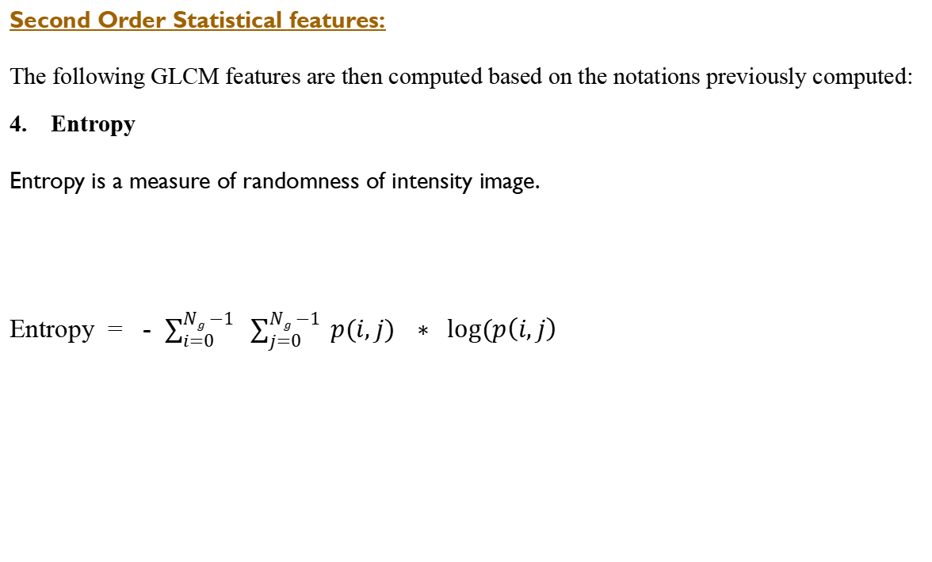
medical Image Analysis
Image Features [Hand-Crafted Features / Manual Features]:
Second Order Statistical features:
The following GLCM features are then computed based on the notations previously computed:
4. Entropy
Entropy is a measure of randomness of intensity image.
Entropy = - $\sum_{i=0}^{Ng −1}{ }$ $\sum_{j=0}^{Ng −1}{ p(i,j)} ∗ log⁡(p\left(i,j\right)$
Source Courtesy: https://www.uio.no/studier/emner/matnat/ifi/INF4300/h08/undervisningsmateriale/glcm.pdf
https://shodhganga.inflibnet.ac.in/bitstream/10603/20682/14/14_chapter%205.pdf

Slide 23
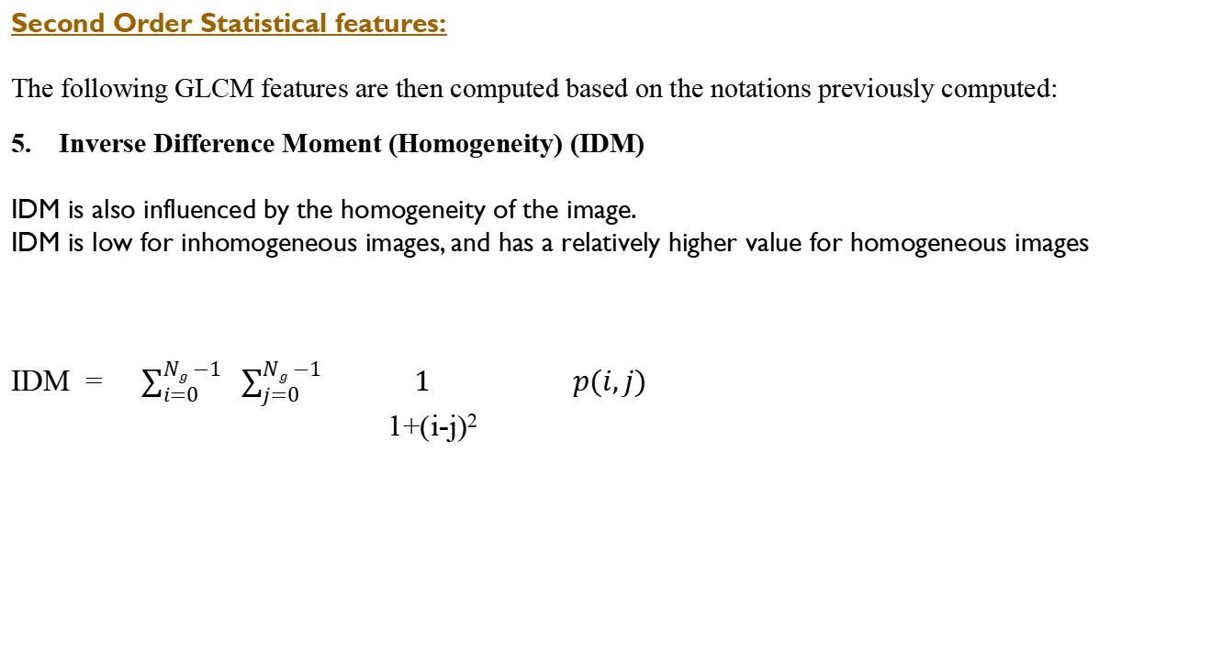
medical Image Analysis
Image Features [Hand-Crafted Features / Manual Features]:
Second Order Statistical features:
The following GLCM features are then computed based on the notations previously computed:
5. Inverse Difference Moment (Homogeneity) (IDM)
IDM is also influenced by the homogeneity of the image.
IDM is low for inhomogeneous images, and has a relatively higher value for homogeneous images
IDM = $\sum_{i=0}^{Ng −1}{ }$ $\sum_{j=0}^{Ng −1}{ 1 p(i,j)}$
1+(i-j)²

Slide 24
medical Image Analysis
Image Features [Hand-Crafted Features / Manual Features]:
Second Order Statistical features:
Based on constructed GLCM matrix (G) Haralick proposed a set of features to describe texture of the
Image.
The following notations are used to compute Haralick features:
Haralick Features
0º
Haralick Features
45º
Haralick Features
IMAGE
90º
Haralick Features
130º
GLCMs

Slide 25
Assignment: Use the matrix on slide # 10 for Numerical for angles 0,45 and d =1 Code GLCM matric construction and feature extraction from glcm matrix

